Slide 1
Relativistic Aberration
(where does it fit into electrodynamics?)
Aran O’Hare
*O’Hare, arXiv:2106.05941
Notes:
Classical not quantum

Slide 2
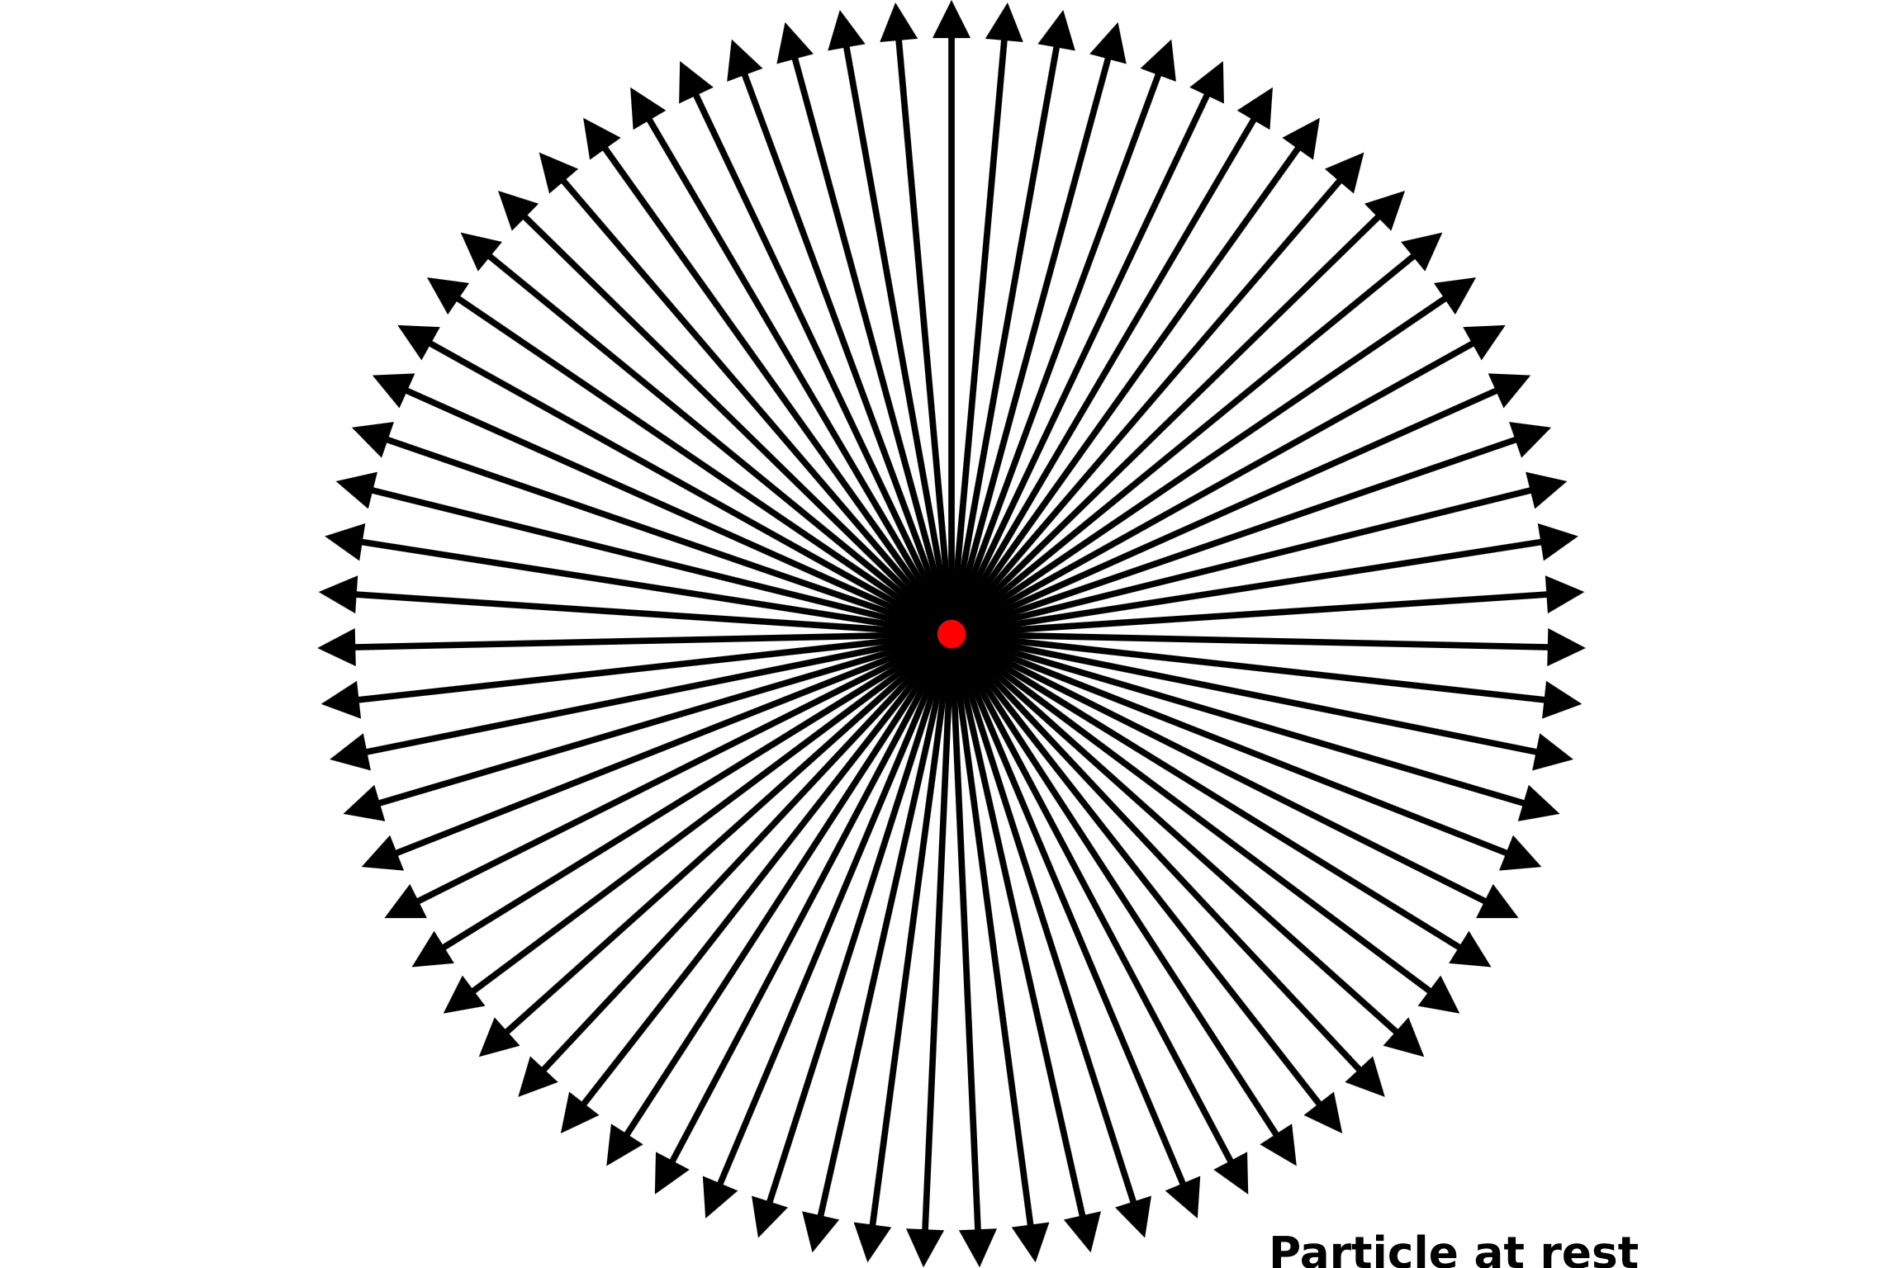
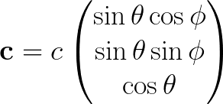
Transforming Spherically Symmetric Luminal emanation
Rest Frame
Notes:
Inertial frames
Describe that the particle is moving but we are just looking at the velocities at the point of the particle at an instance
Talk about angular density
Speed of light!!
Spherically symmetric

Slide 3
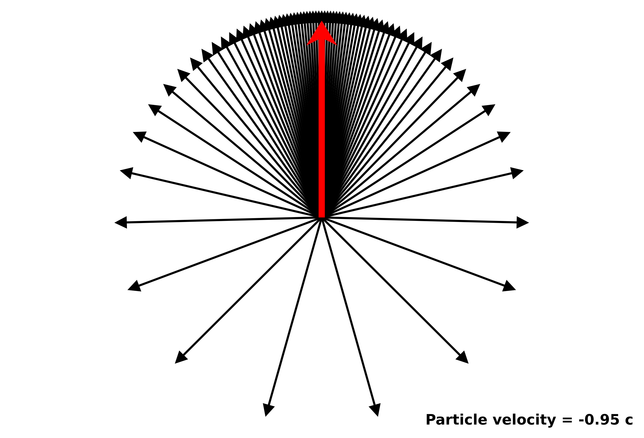
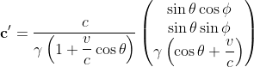
Transforming Spherically Symmetric Luminal emanation
Rest Frame
Primed Frame
Notes:
Inertial frames
Describe that the particle is moving but we are just looking at the velocities at the point of the particle at an instance
Talk about angular density
Speed of light!!
Spherically symmetric

Slide 4
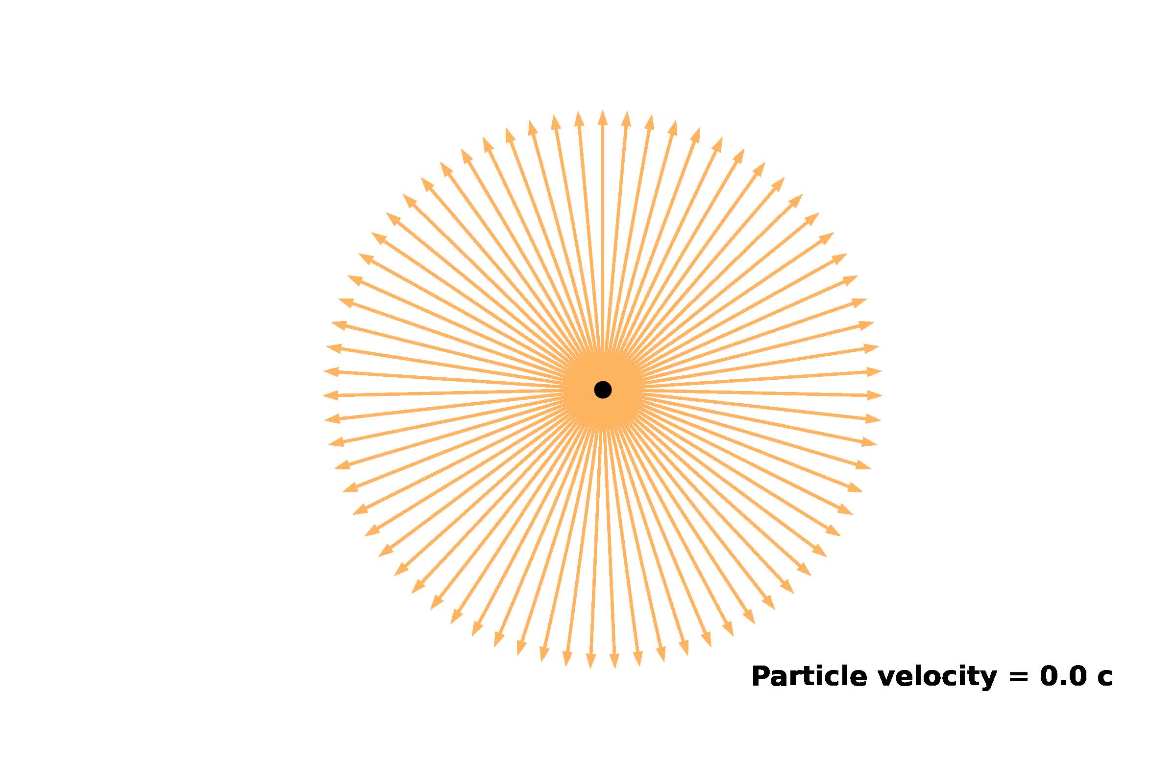

Slide 5
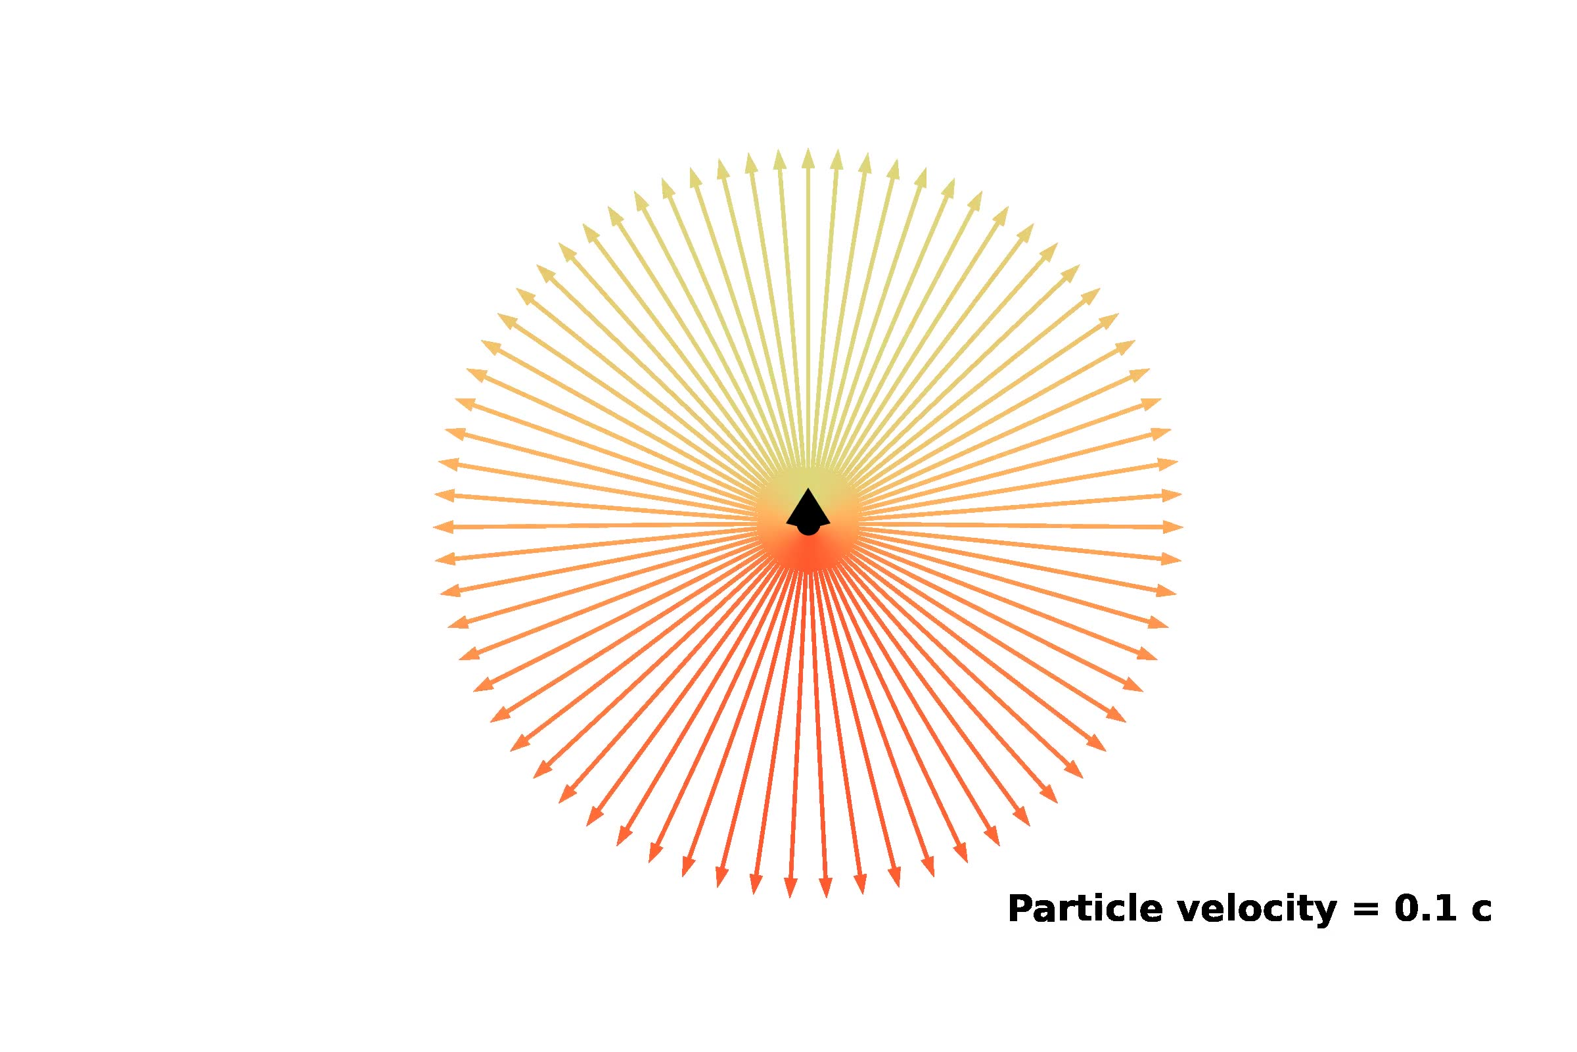

Slide 6
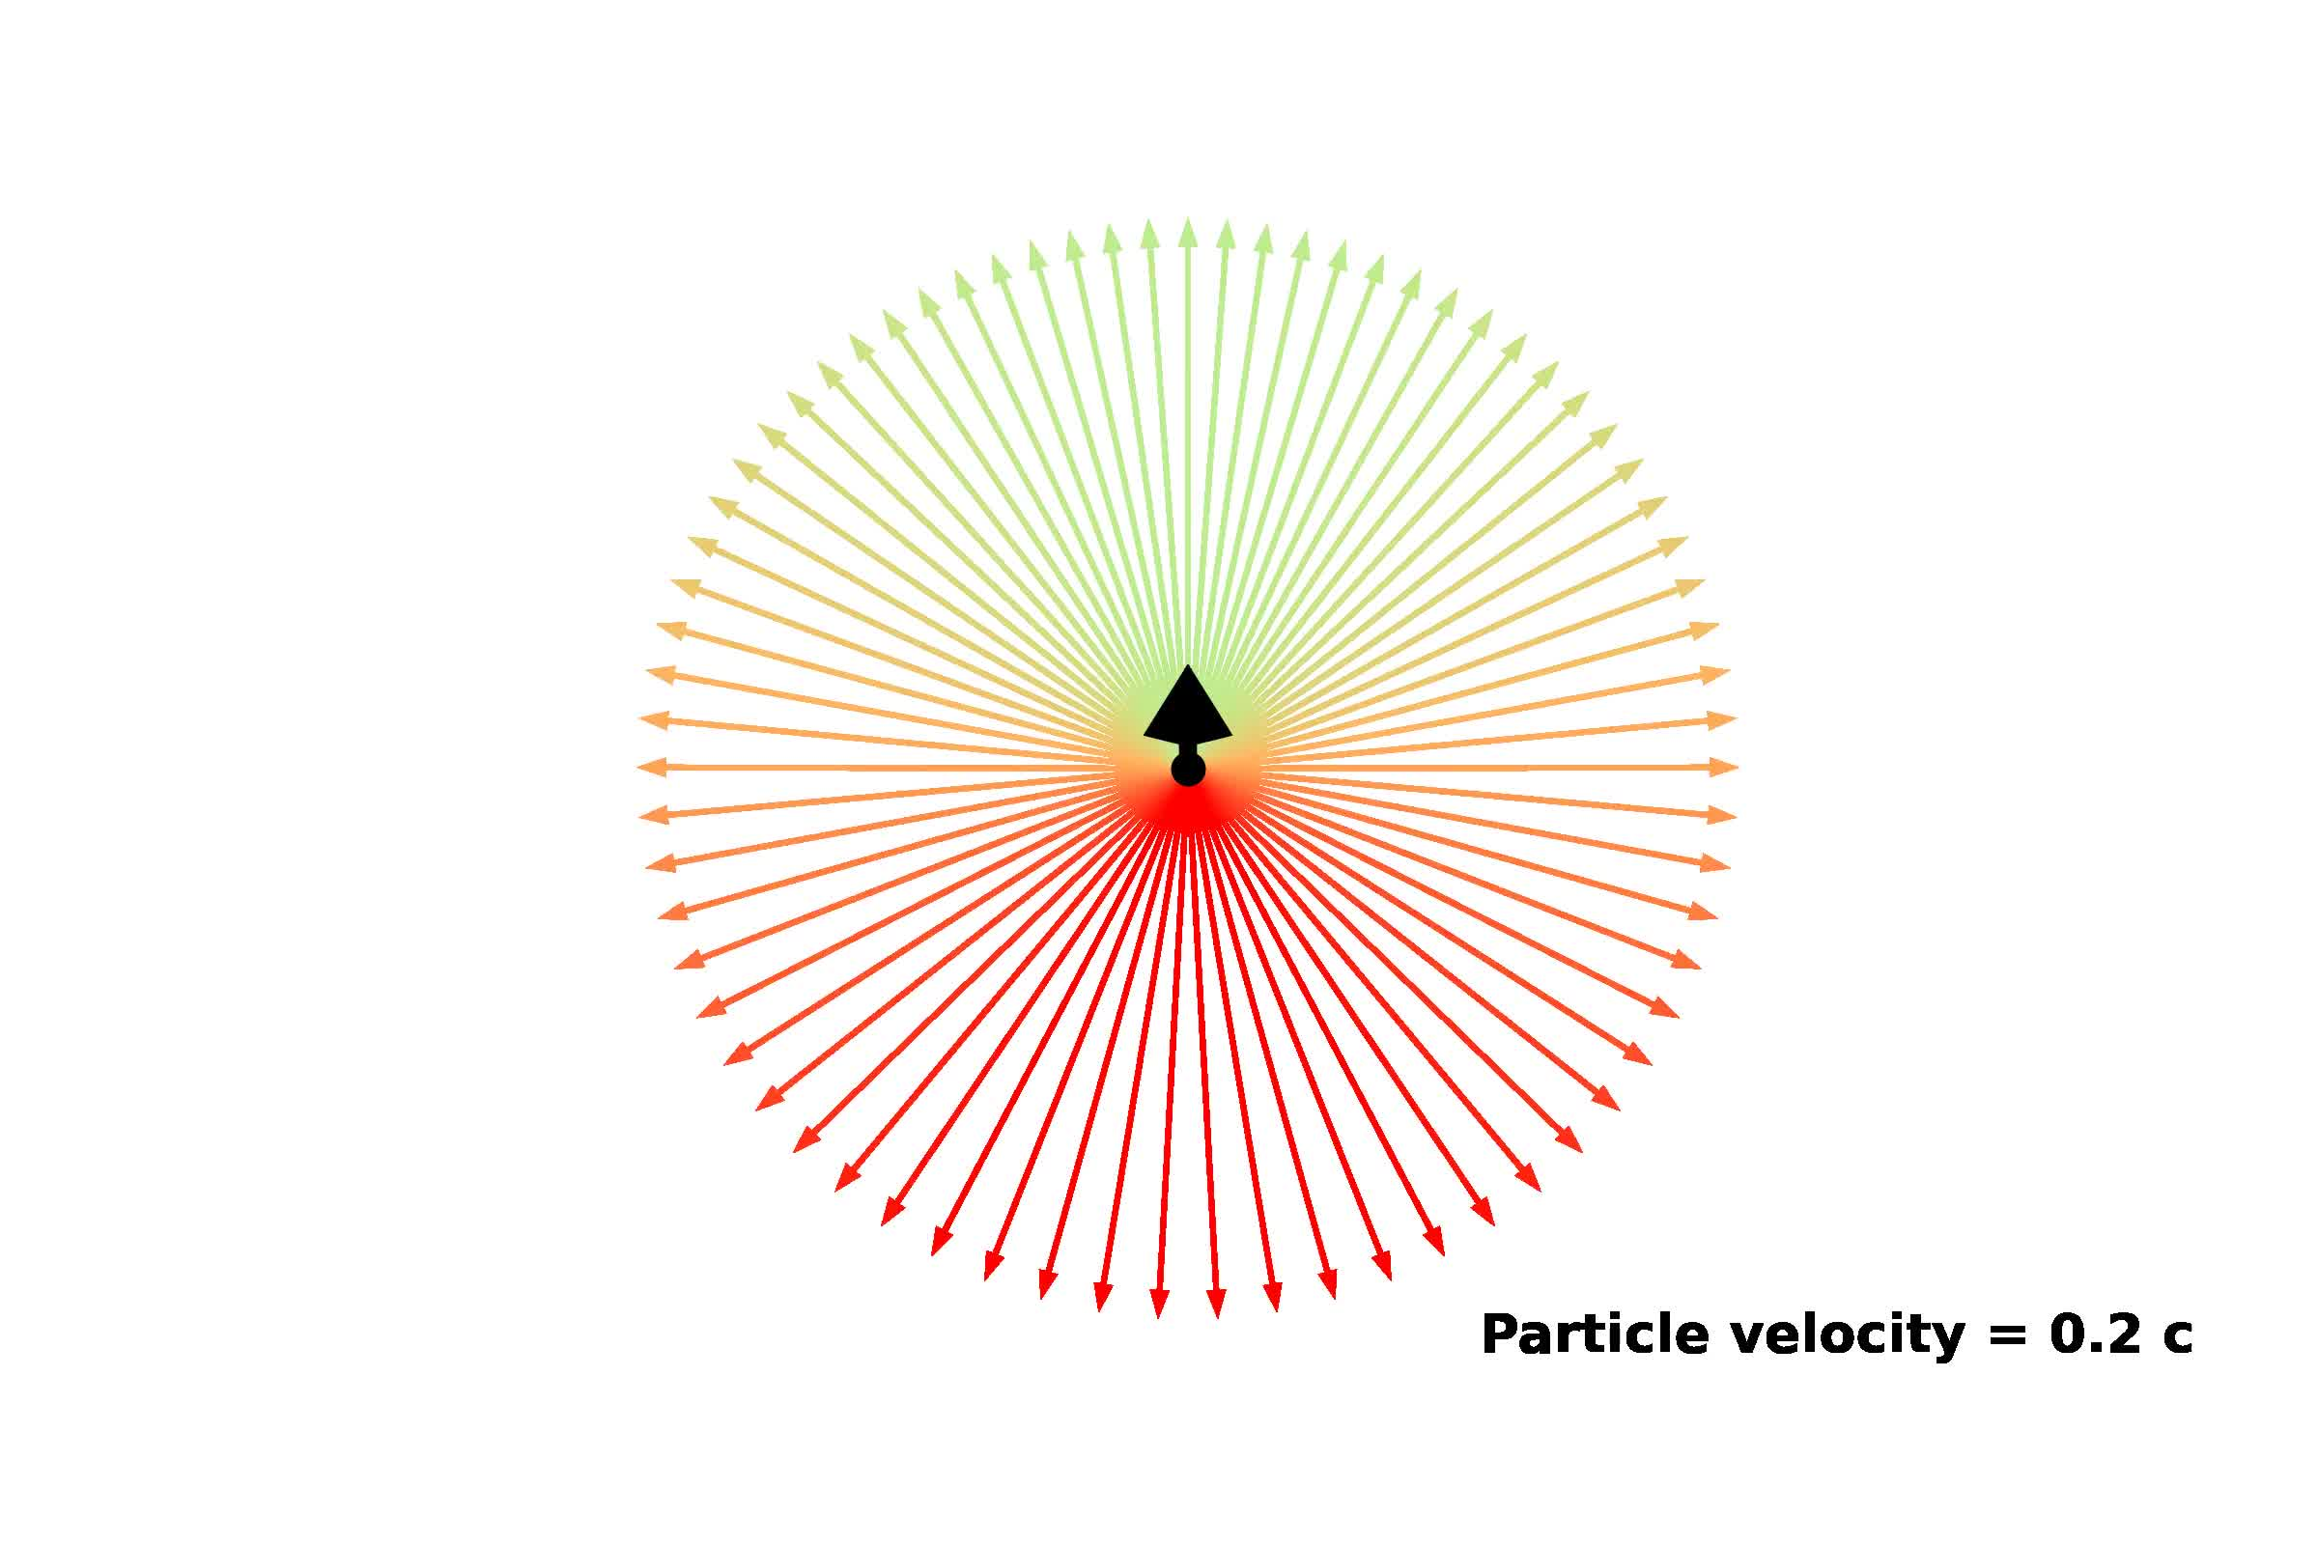

Slide 7
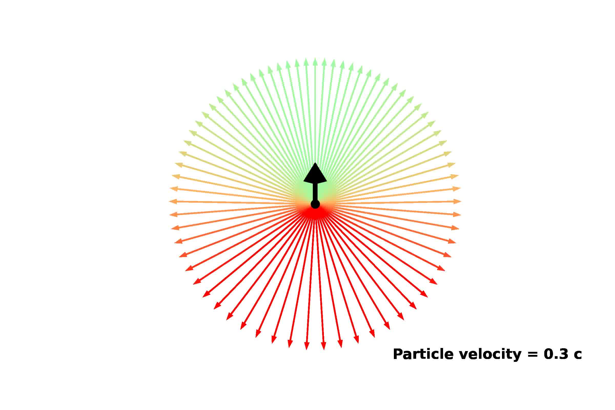

Slide 8
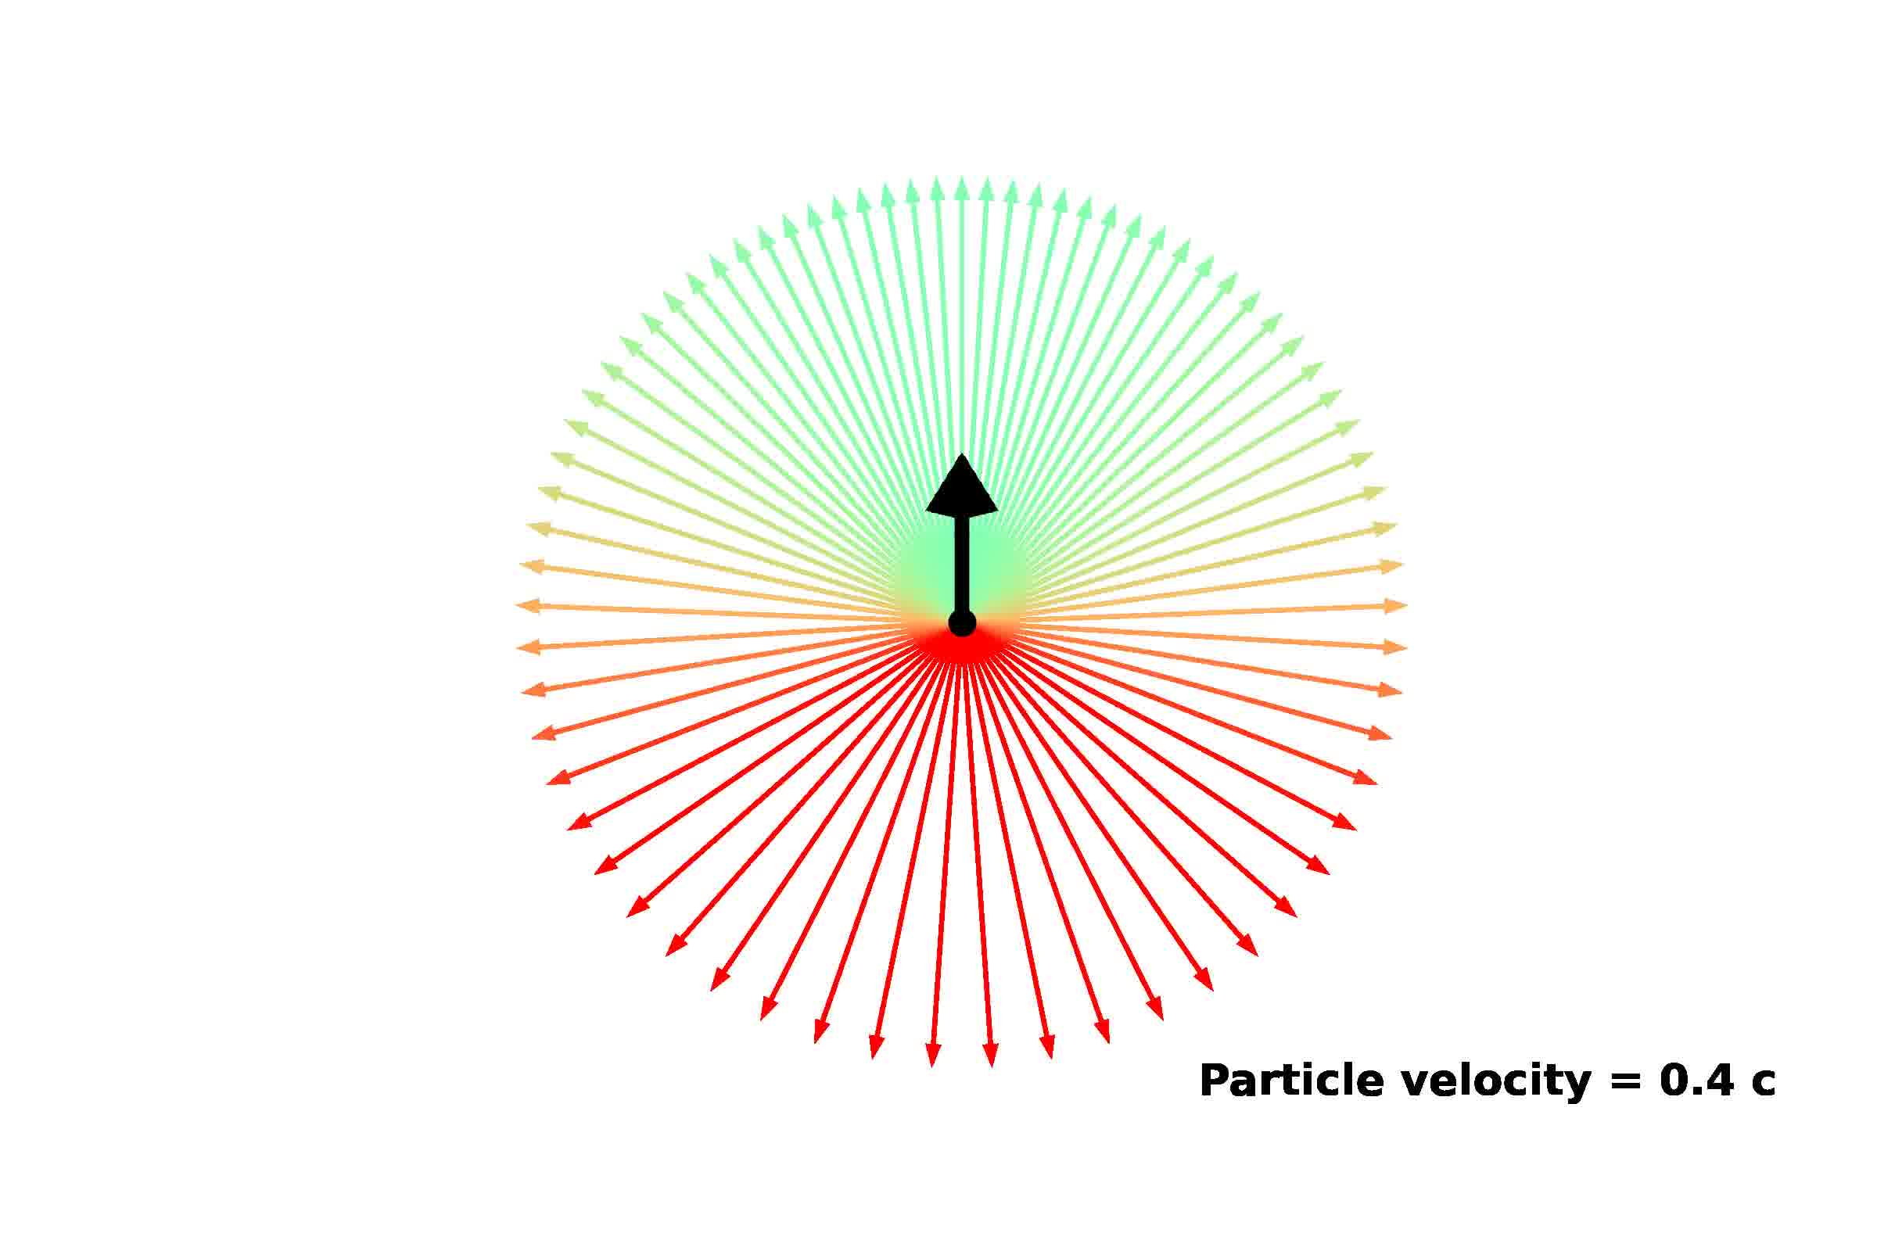

Slide 9
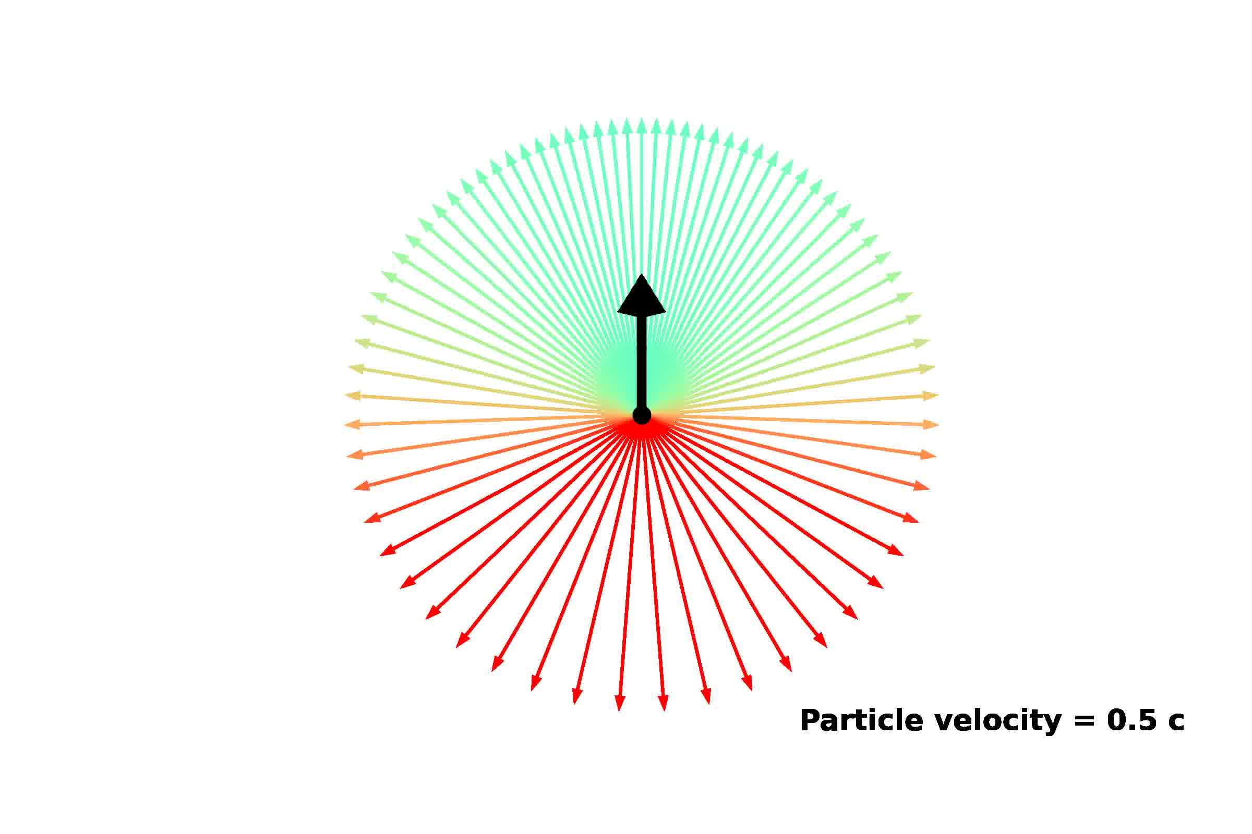

Slide 10
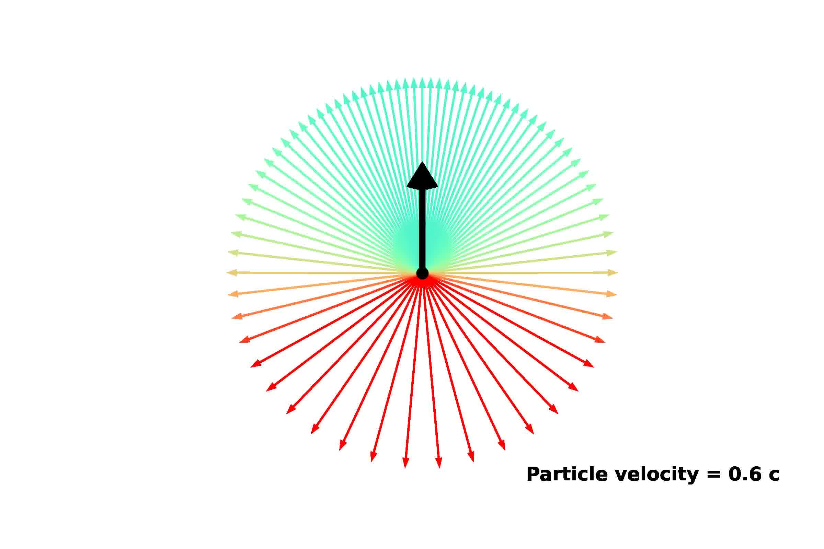

Slide 11
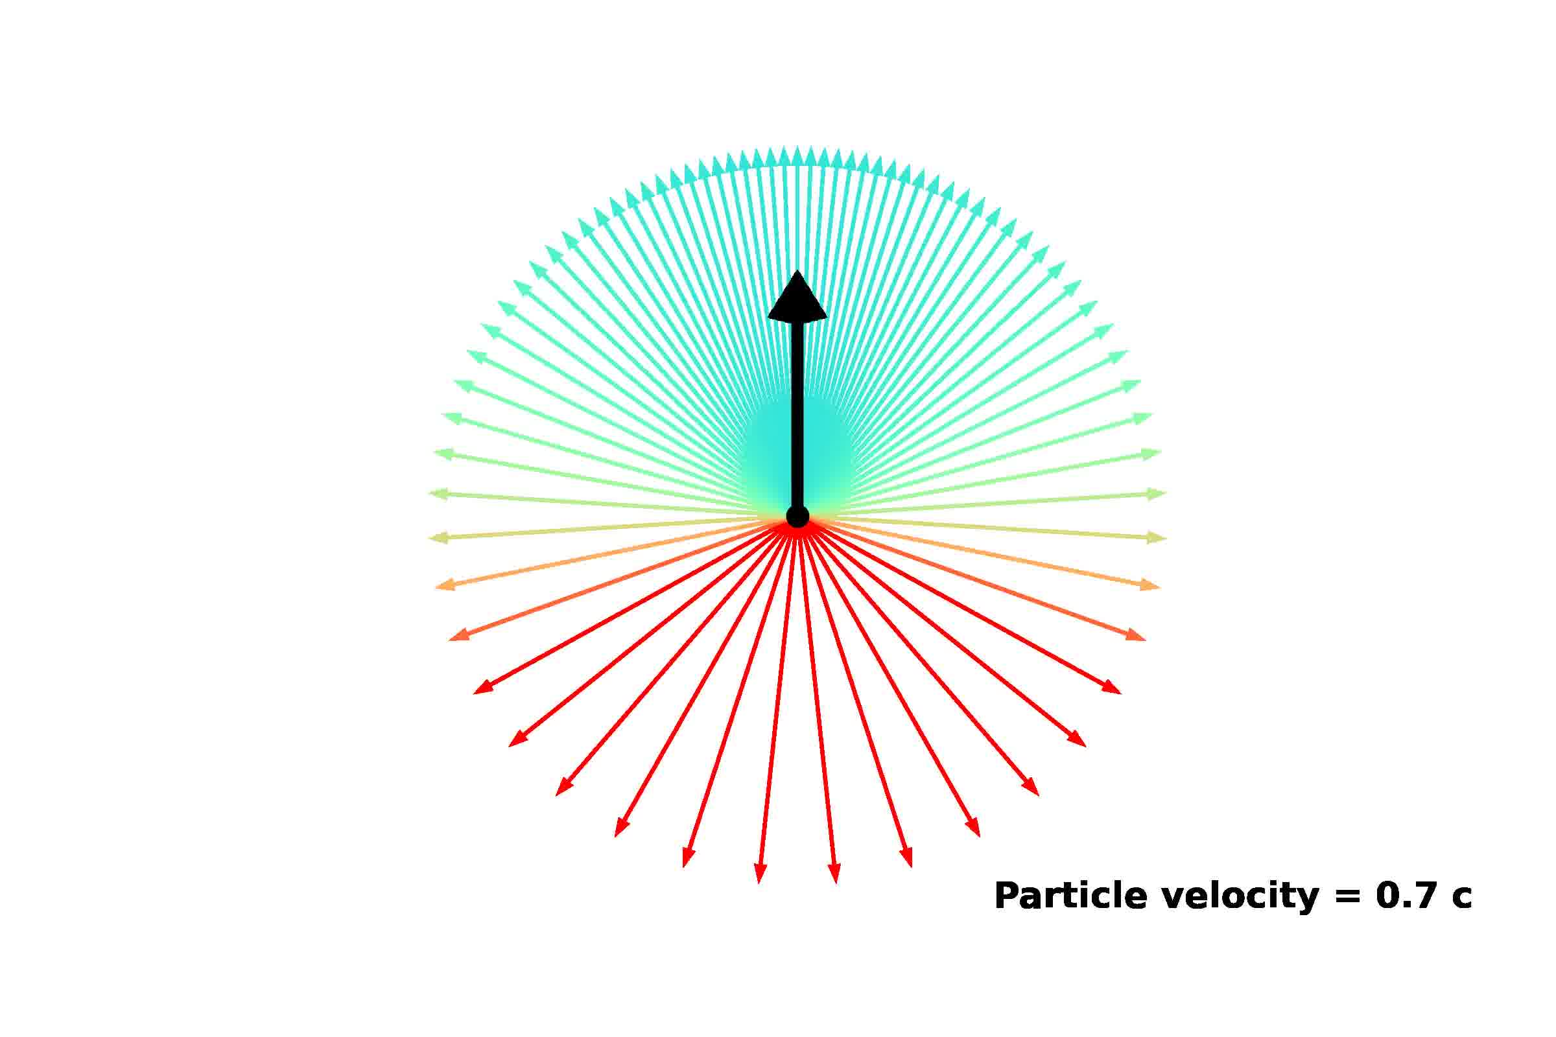

Slide 12
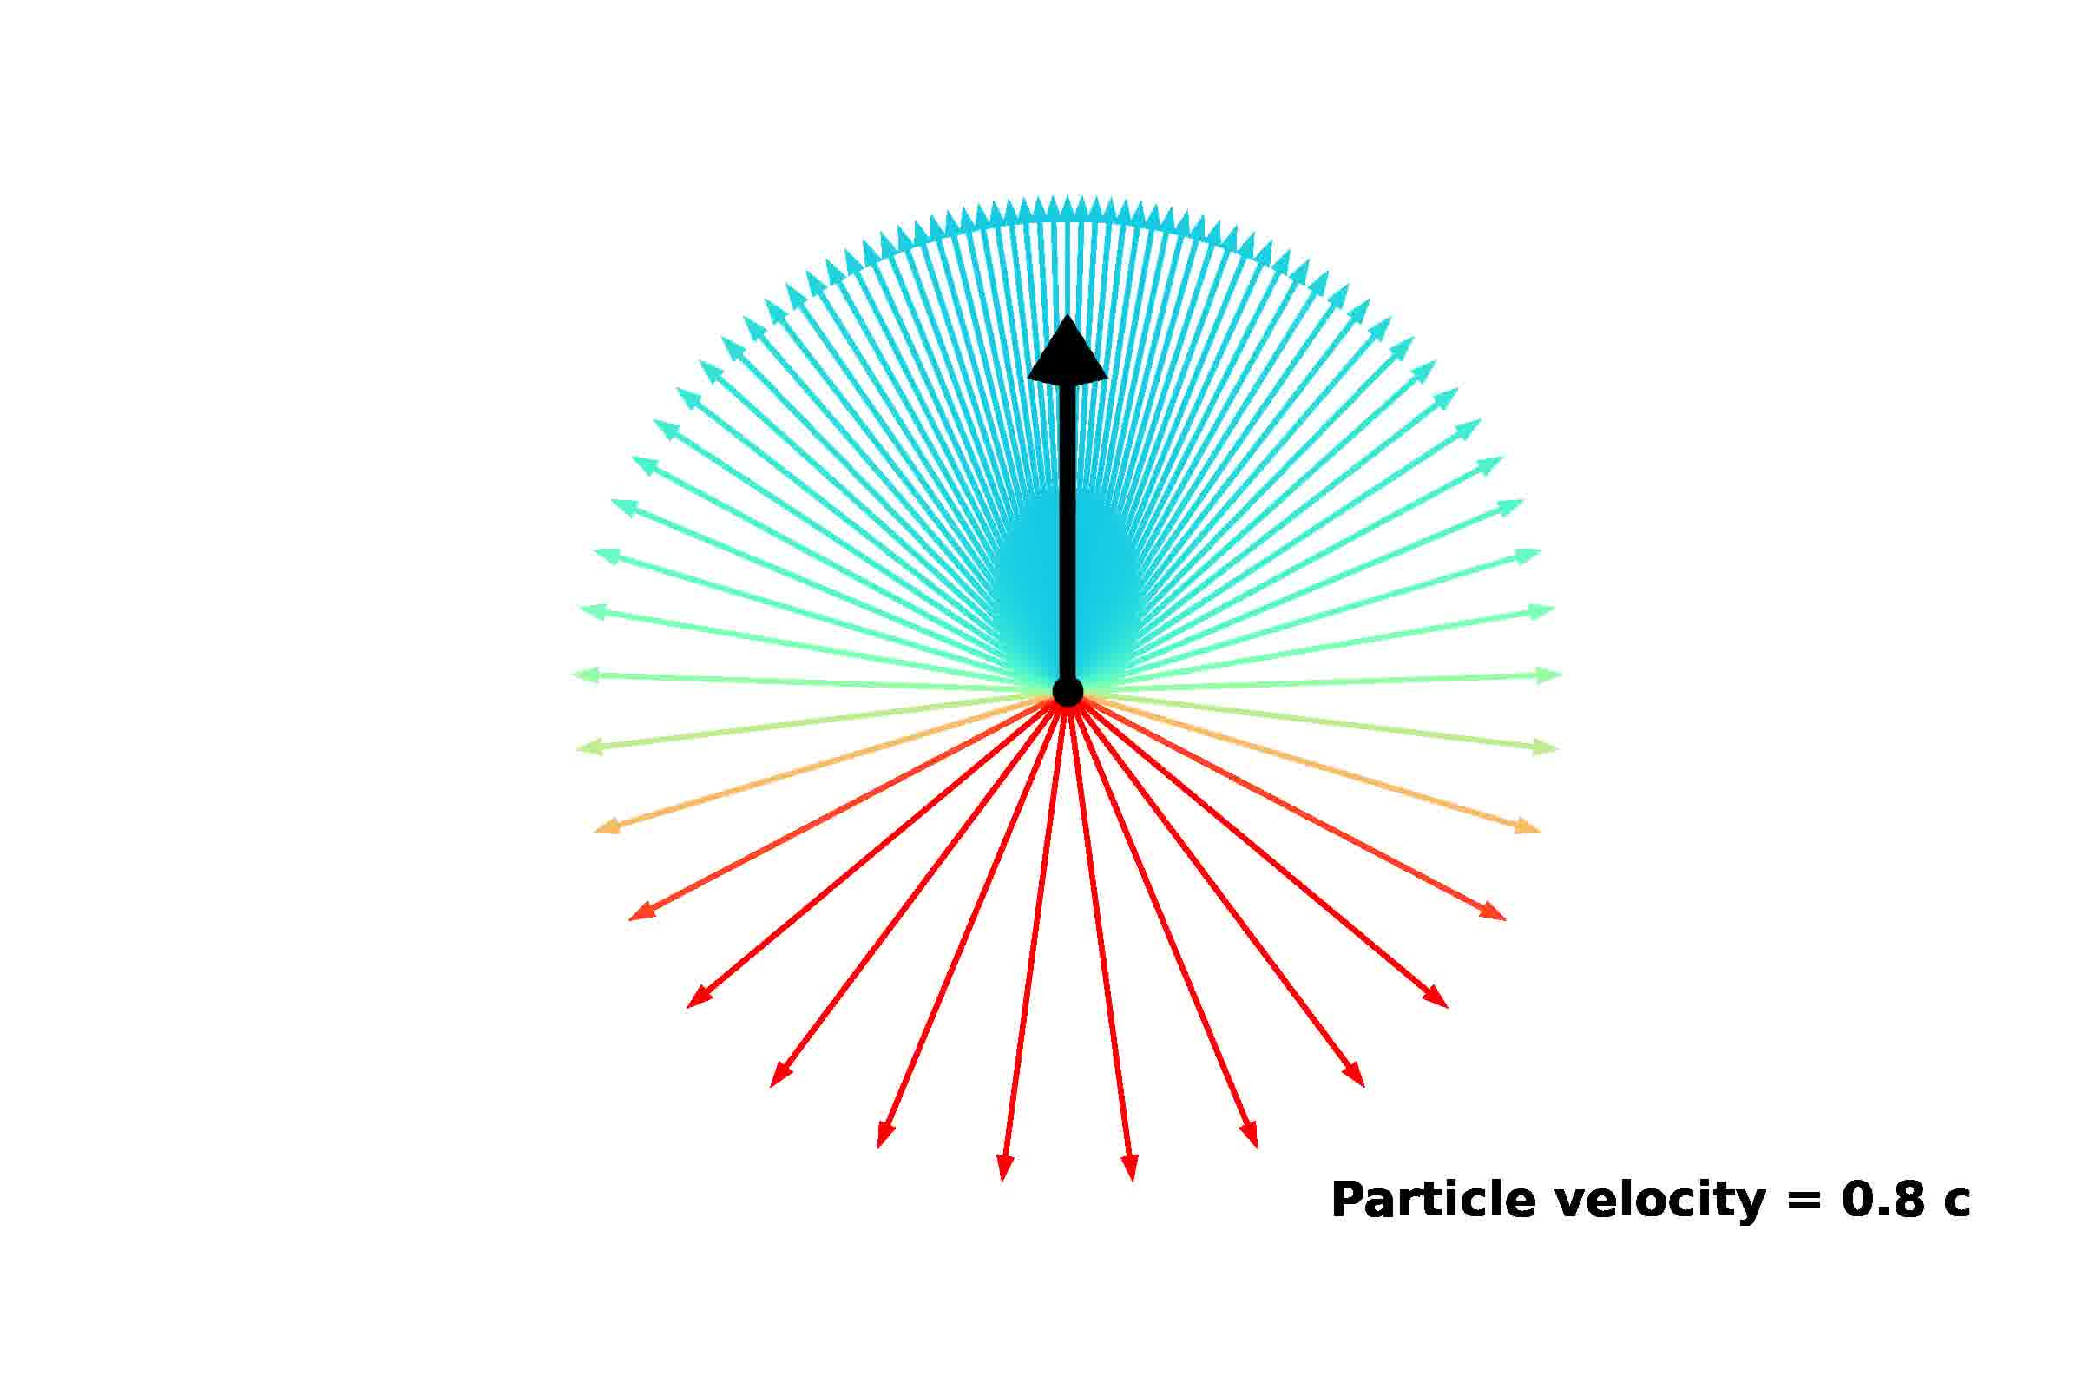

Slide 13
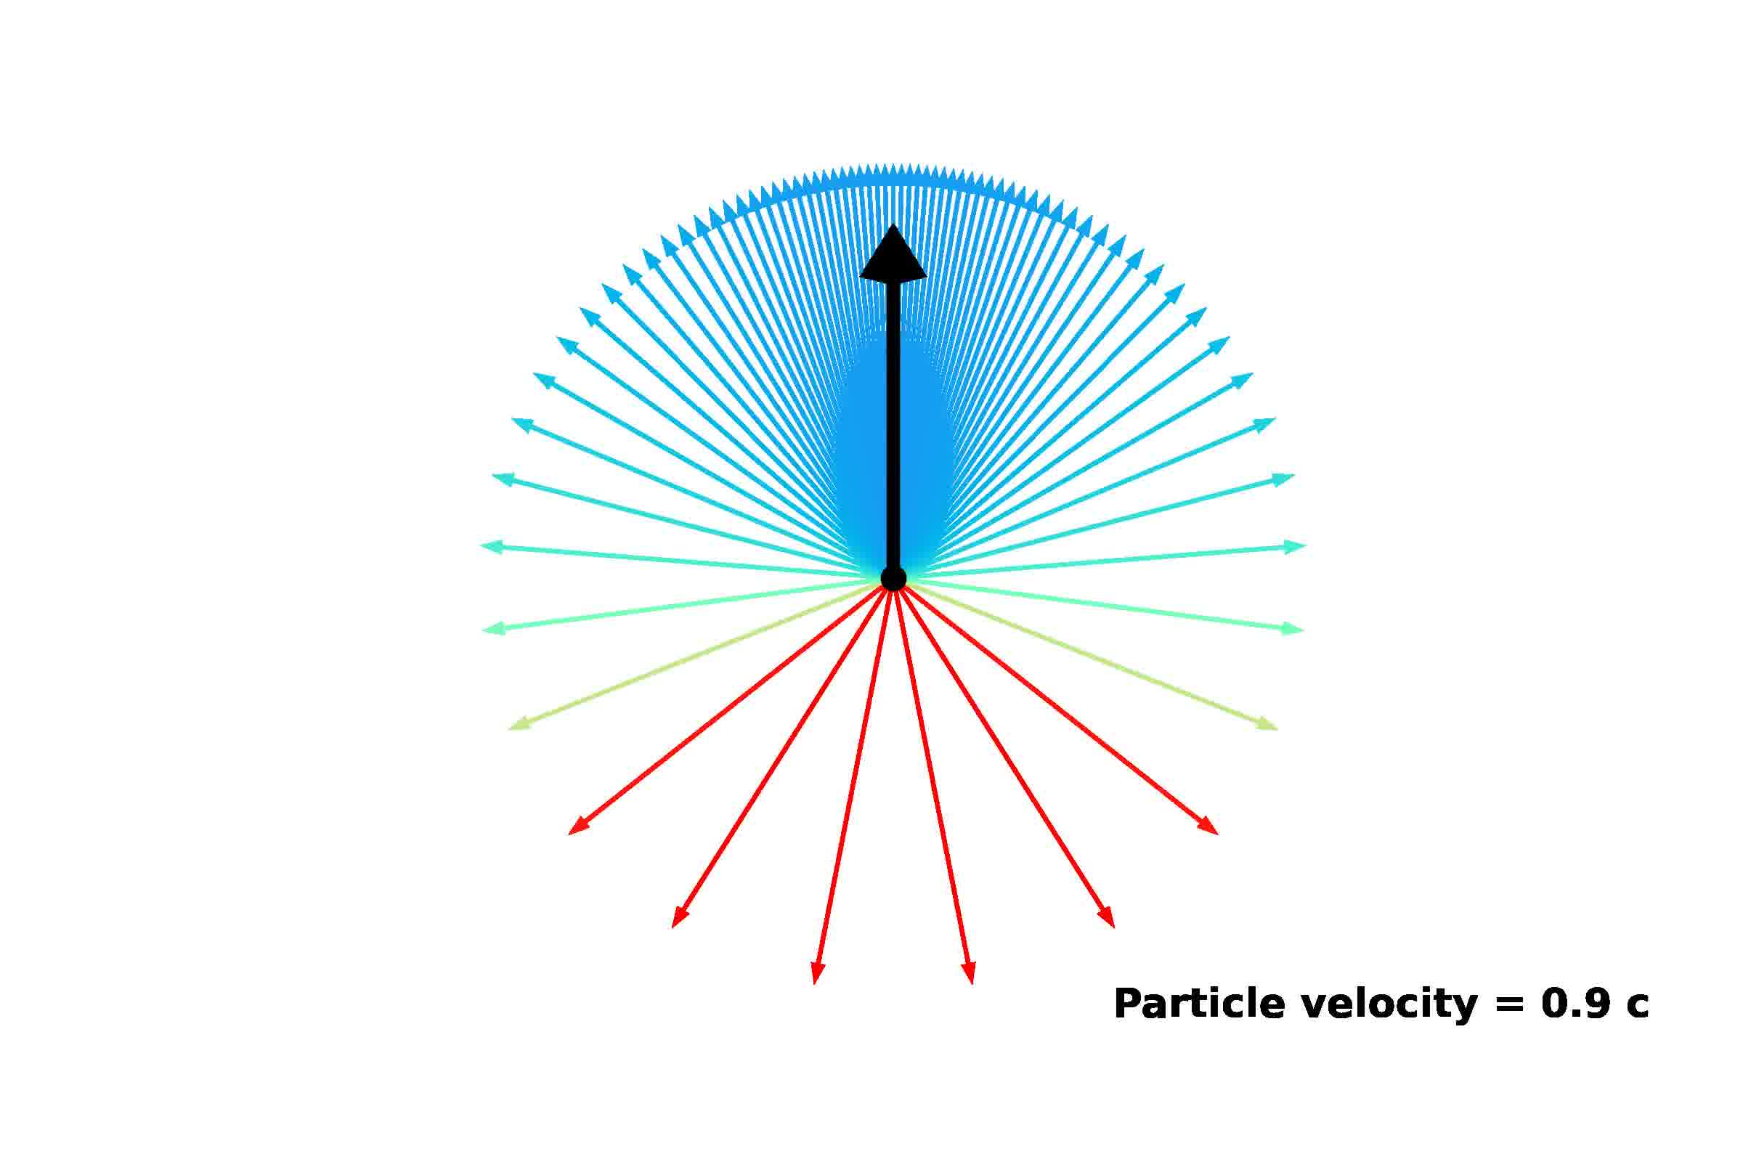
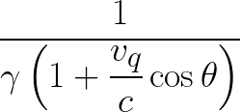
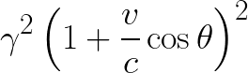
Ratio of the angular density of emanation in Primed frame to rest frame:
Doppler Term, Ratio of radial density of emanation in the primed frame to the rest frame:

Slide 14
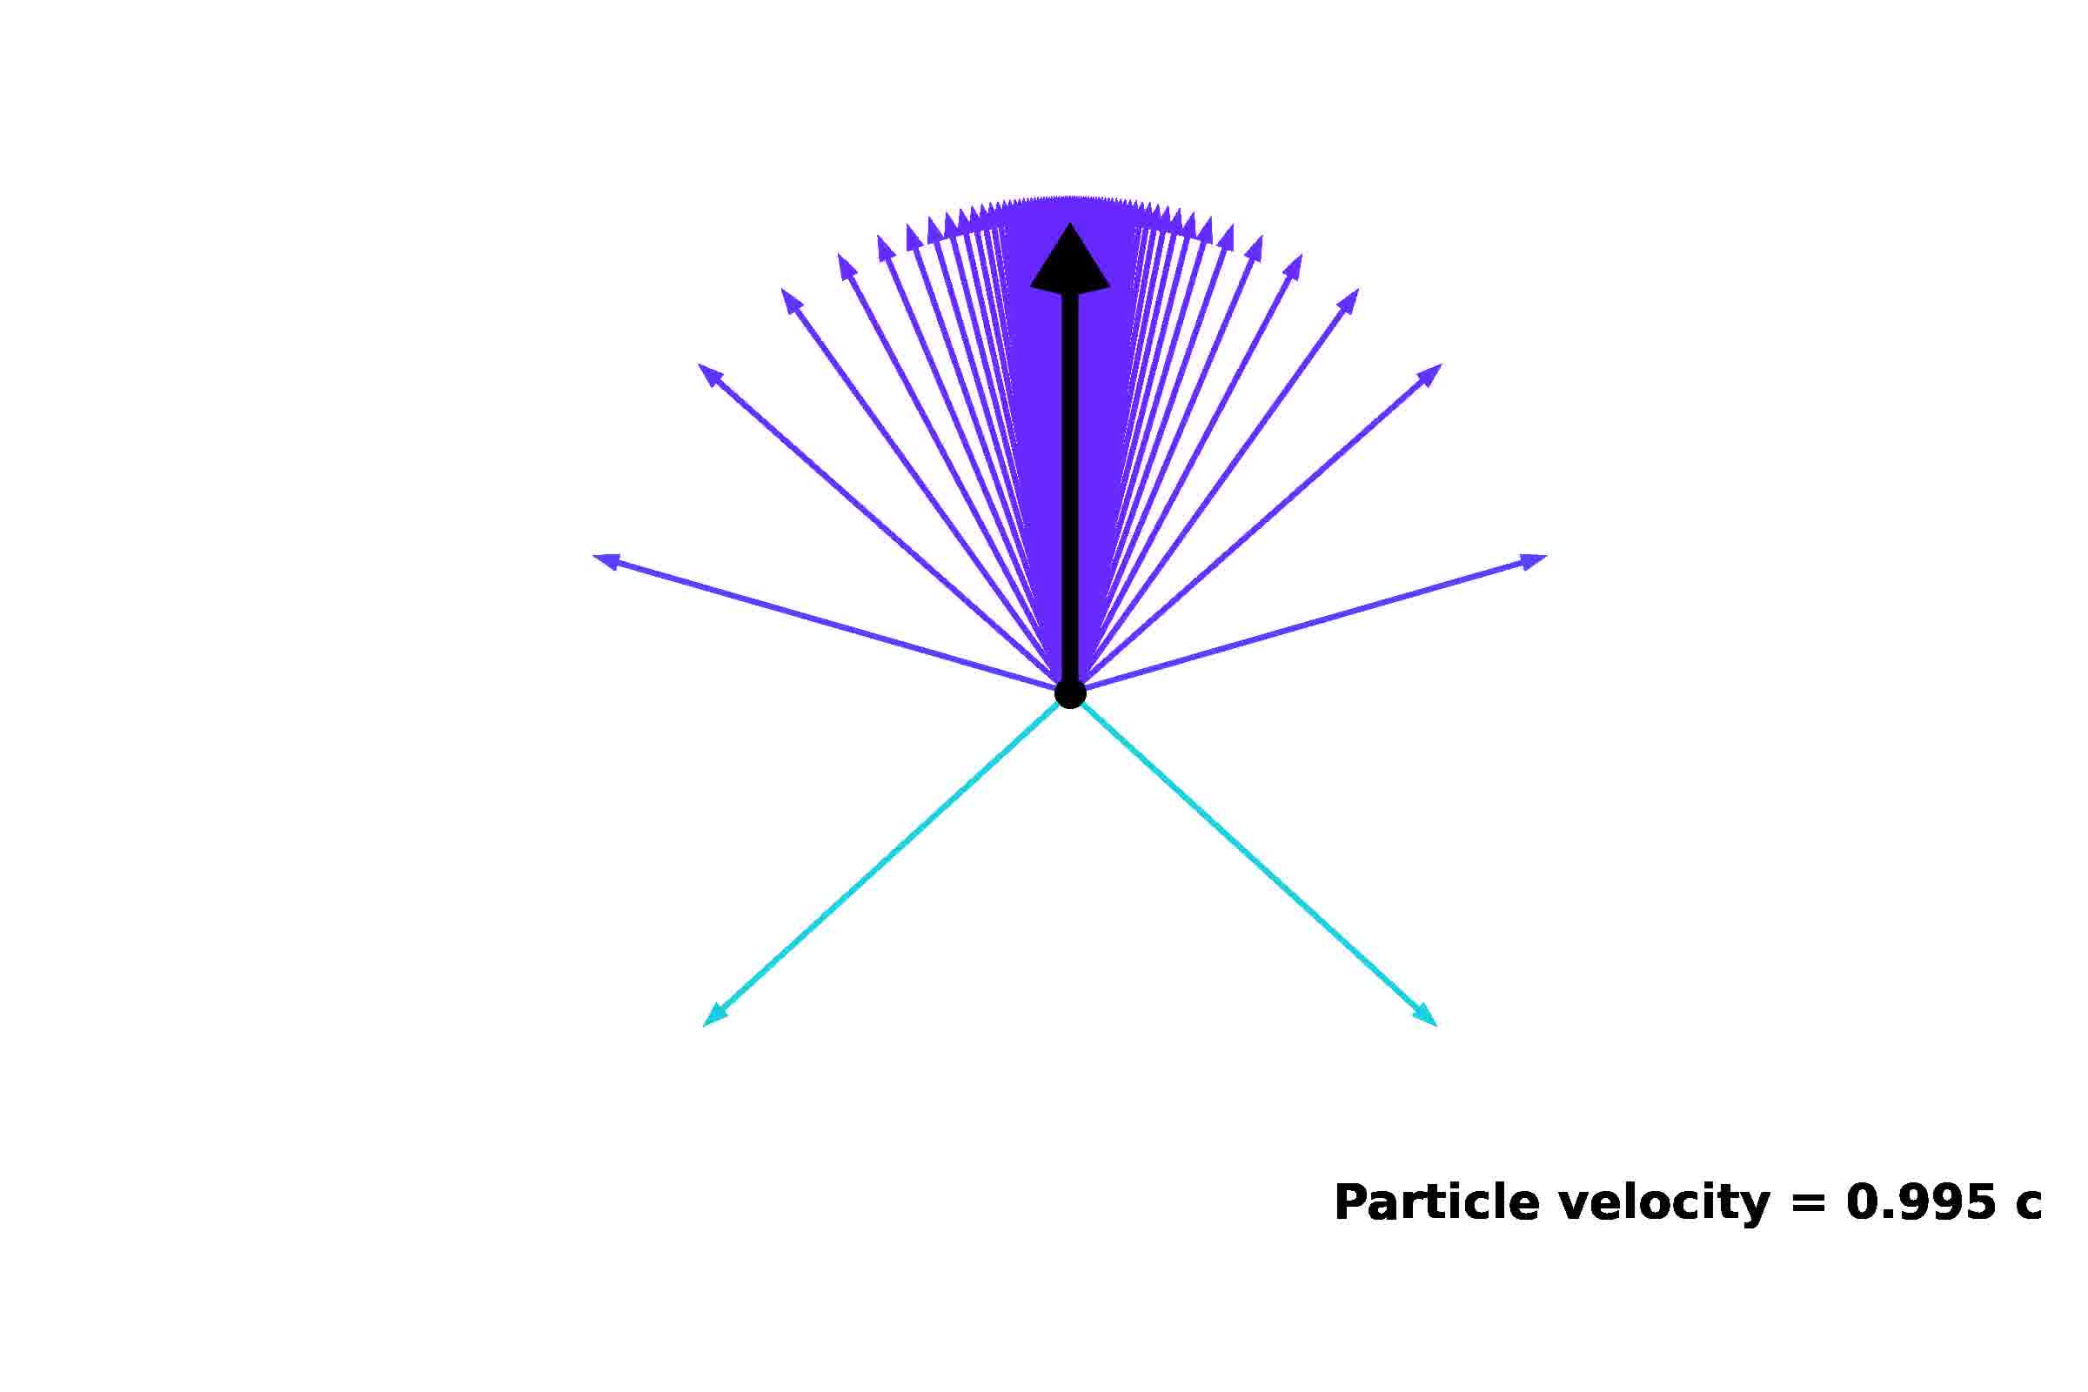
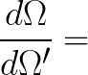
Notes:
eventually all velocities point in direction of movement that’s approaching the speed of light/speed of the emanating field
There is a greater flux of the “field” in the direction of the movement of the particle

Slide 15
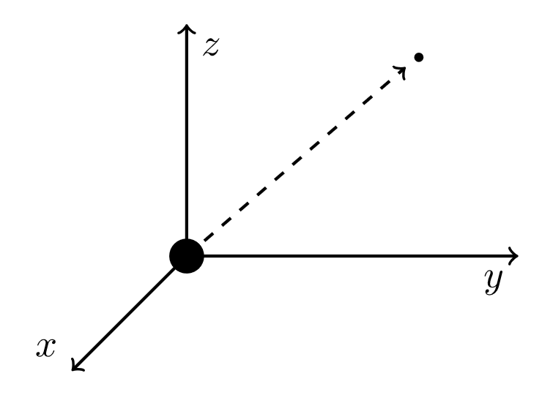
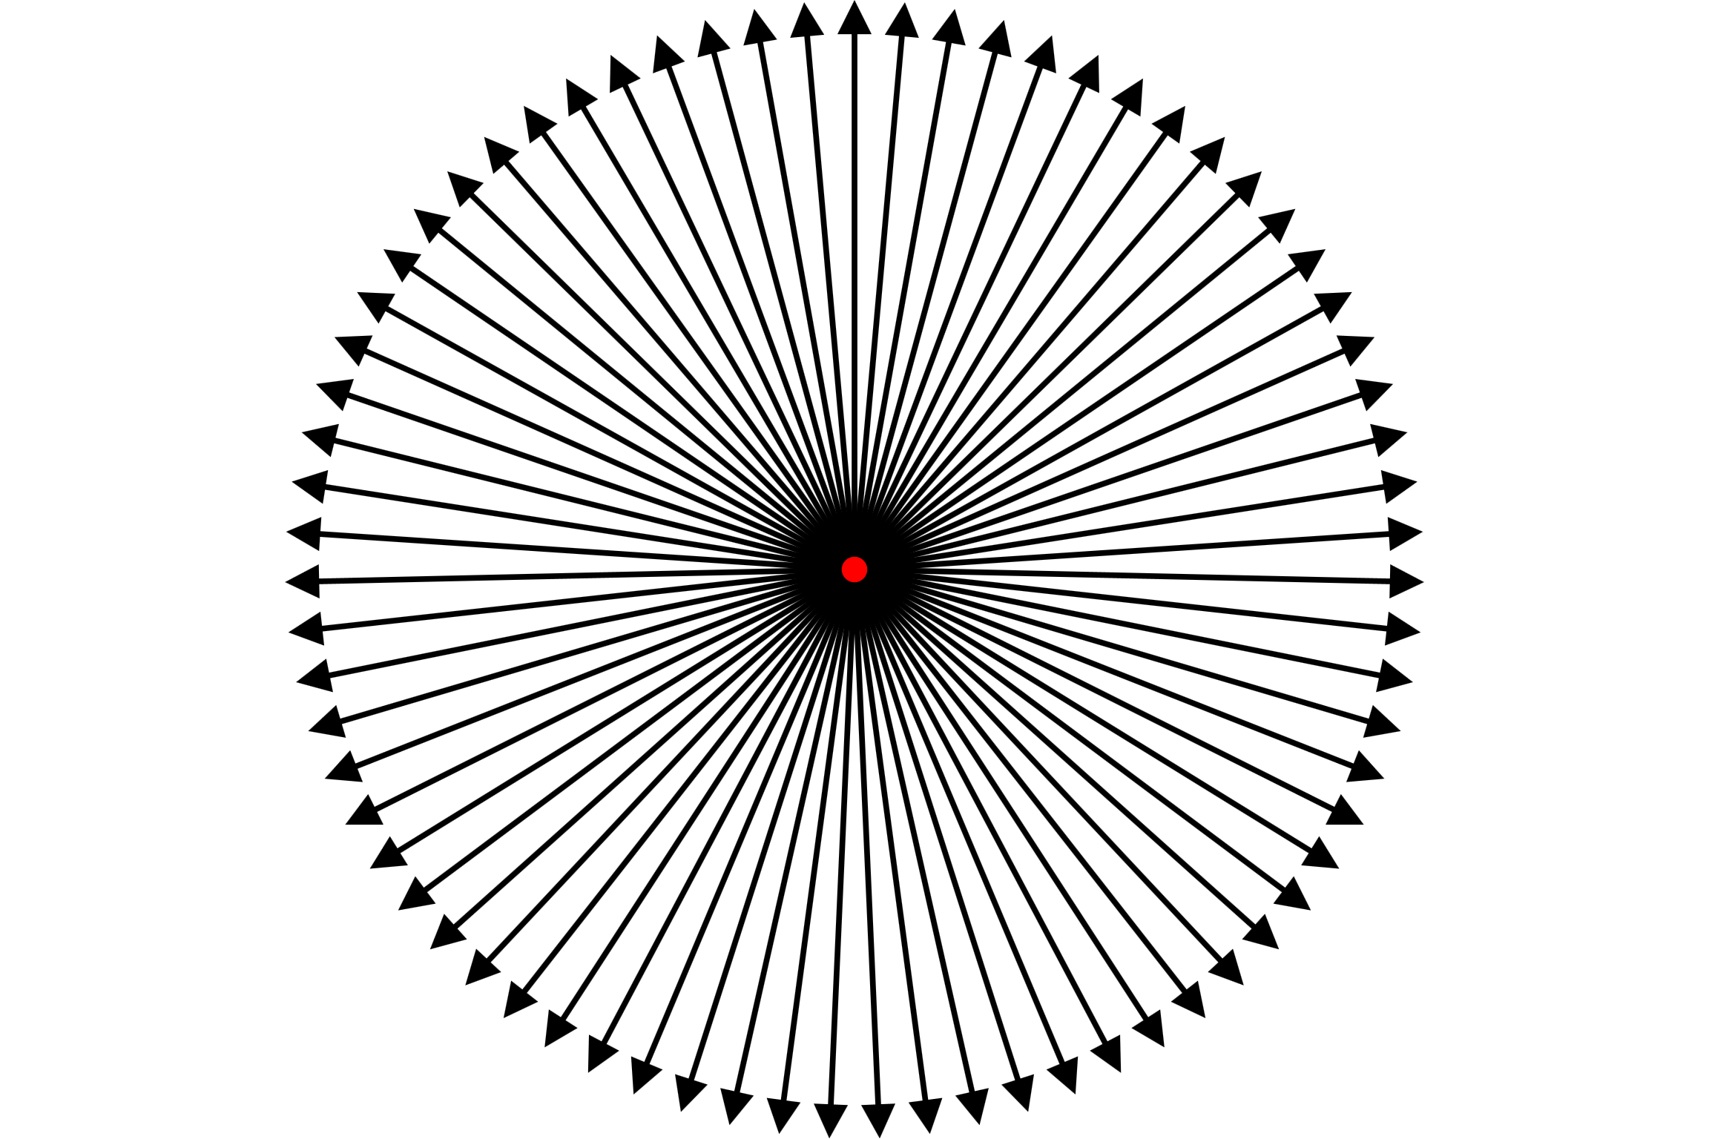
Rest Frame
Notes:
The angular density of the field is Inversely proportional to the distance from the origin

Slide 16
Rest Frame

Slide 17
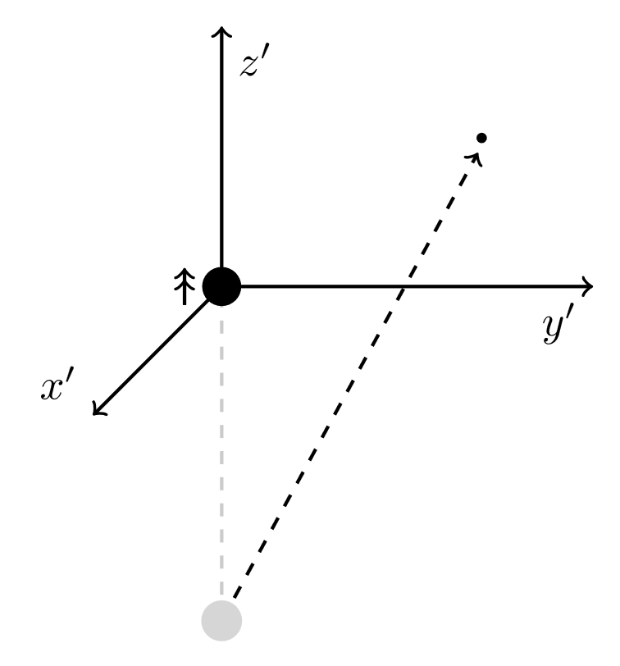
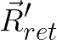
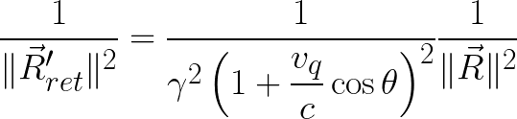
Primed Frame
Rest Frame

Slide 18
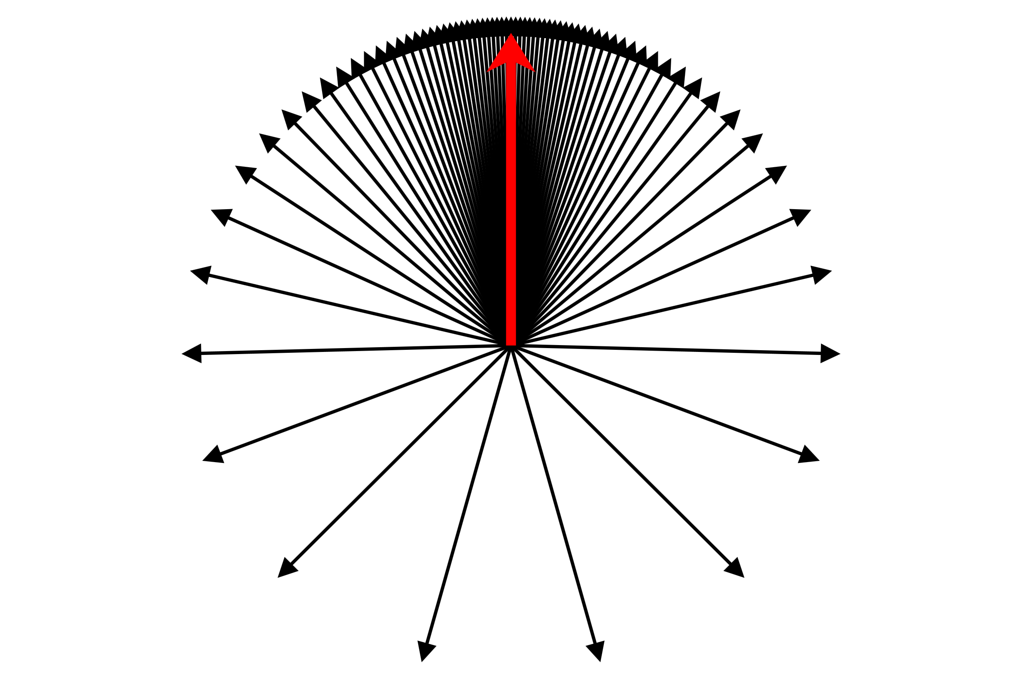
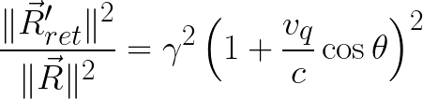
Primed Frame
Rest Frame
Notes:
It turns out that:
The relative angular density between the two frames at the coordinate is equal to the relative (inverse of the of the squared distance)

Slide 19
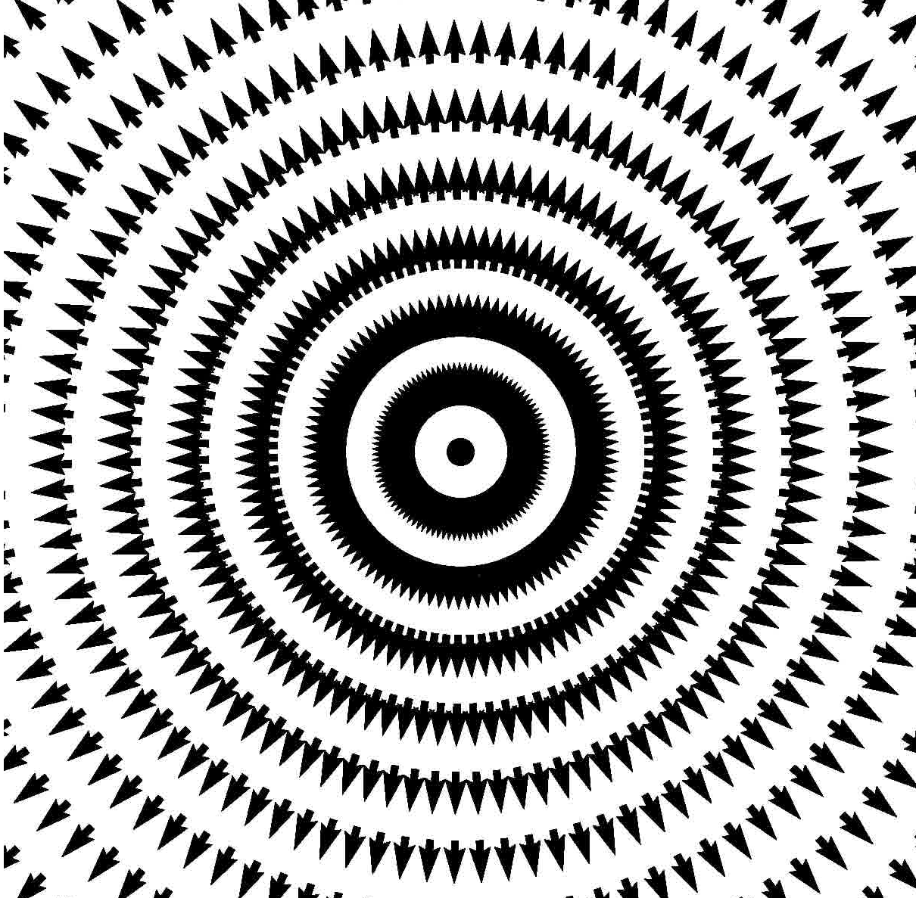
Particle at Rest Field

Slide 20
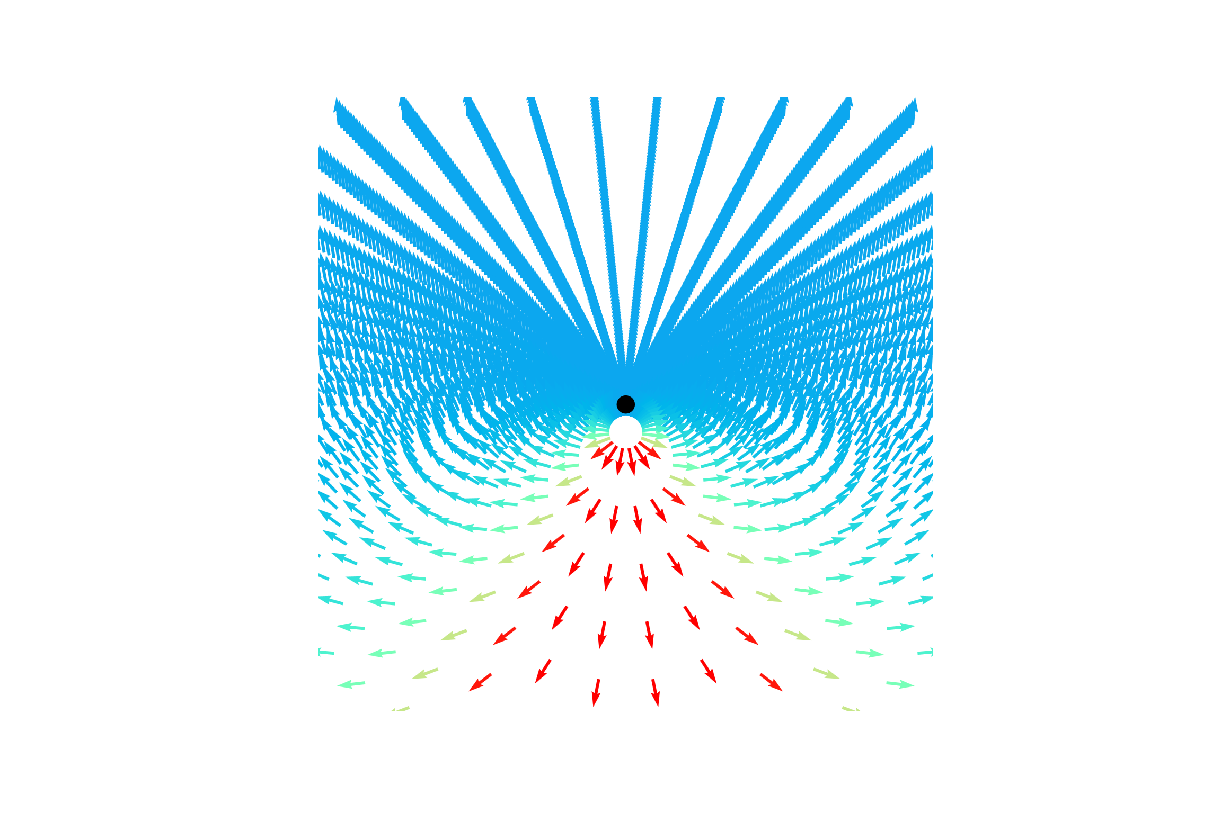
Particle at Rest Field
Moving Particle Field

Slide 21
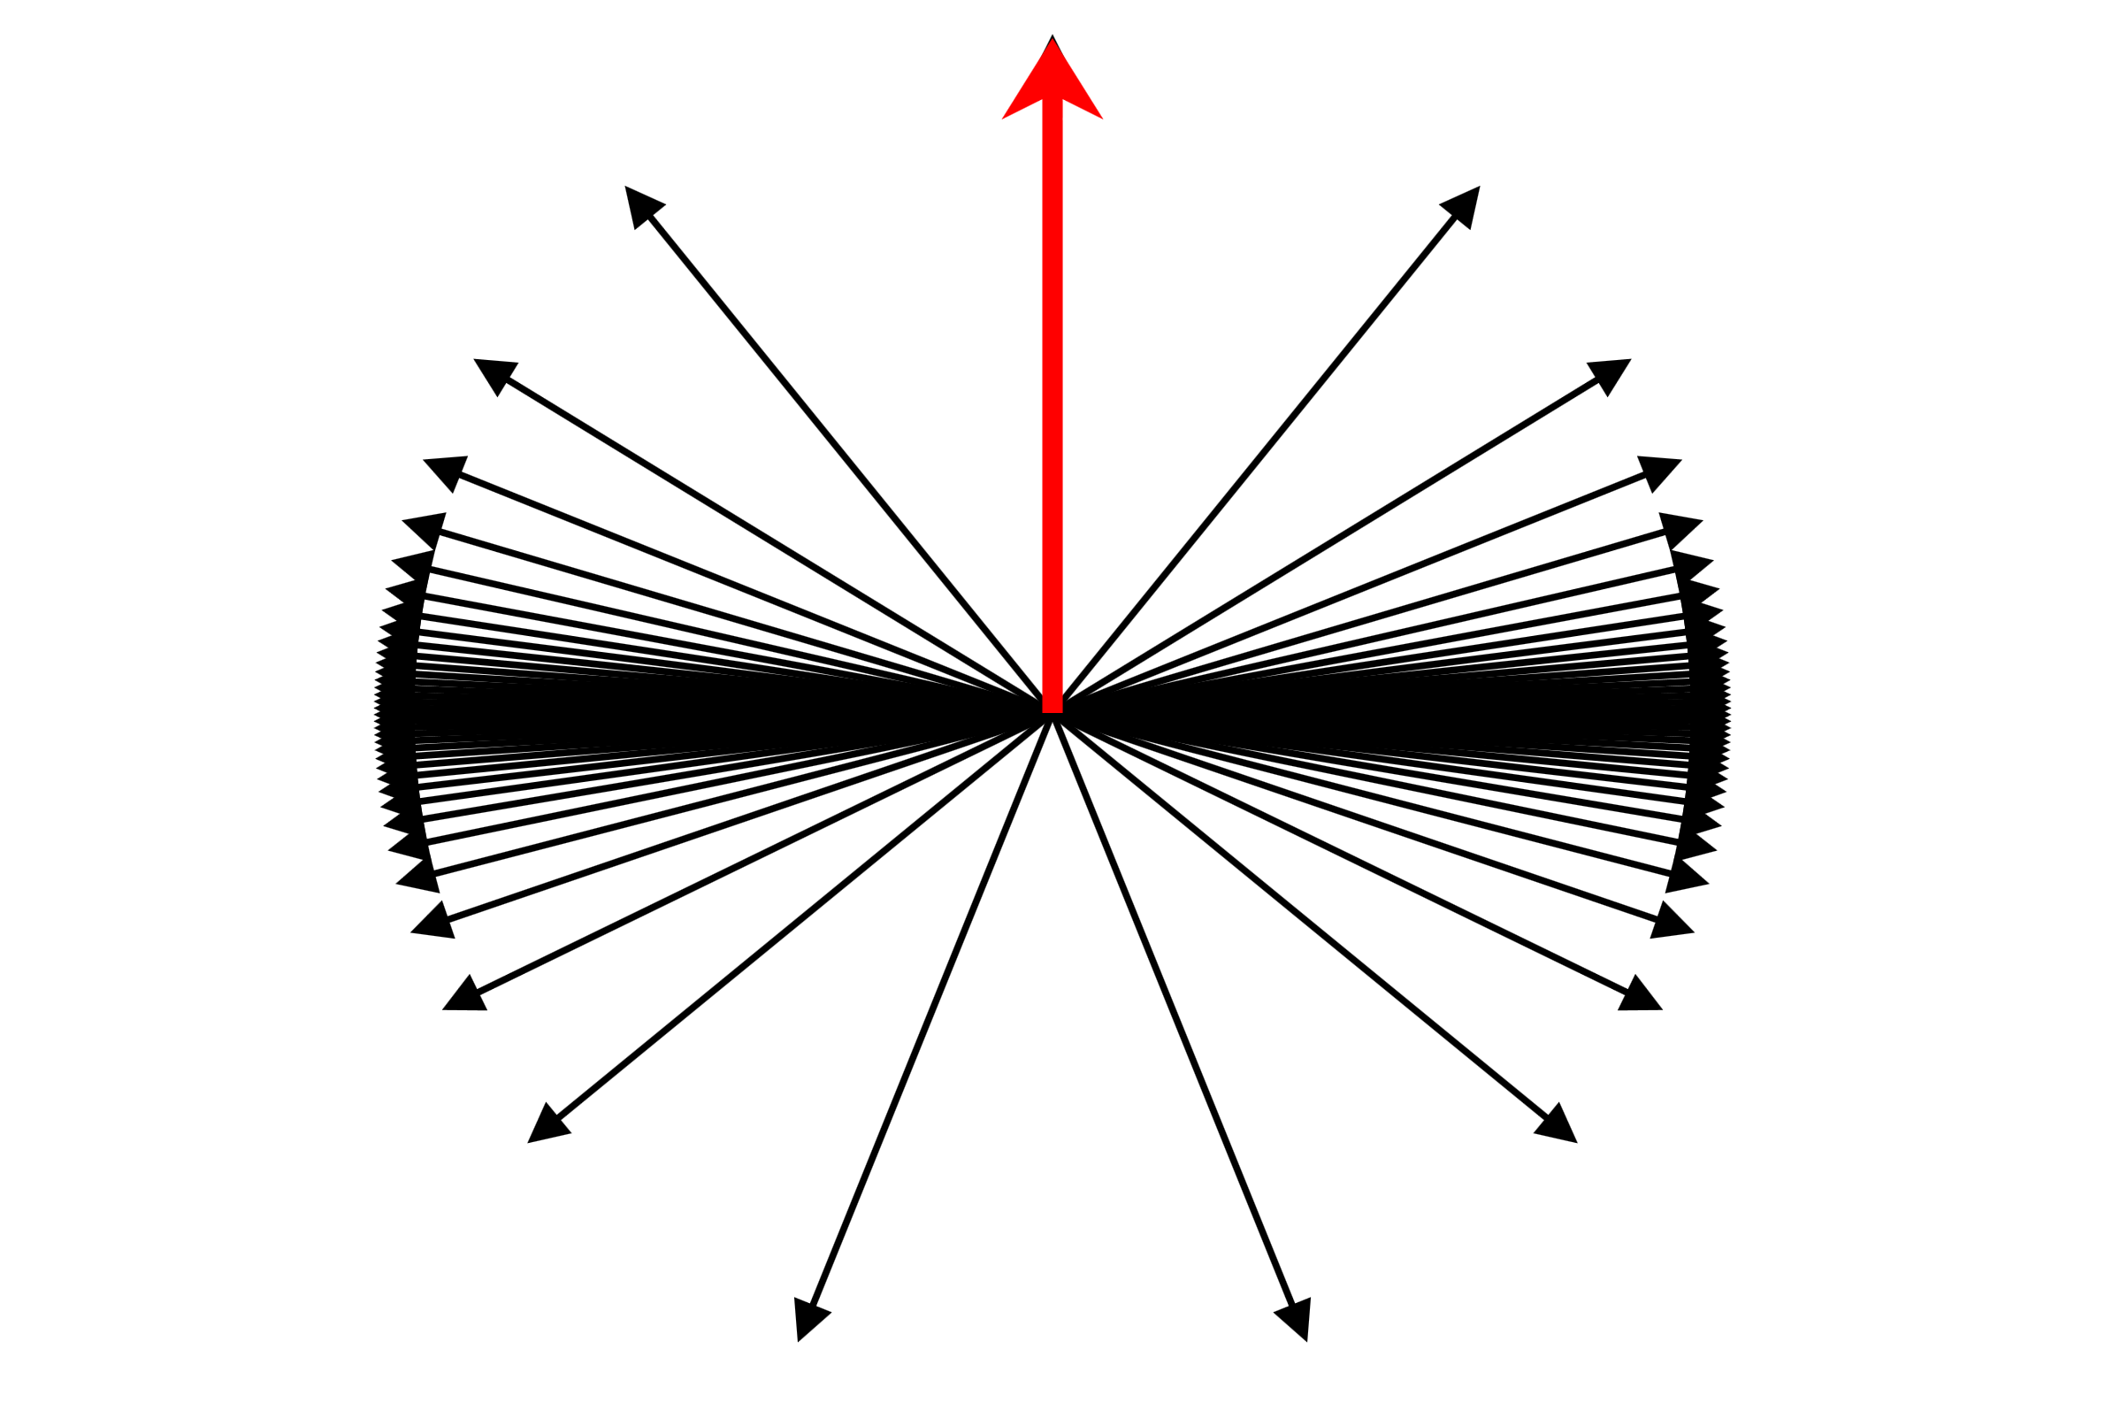
How the Electric Field is Changed in Textbooks
Quite a few textbooks try to explain the Relativistic EM fields using the Lorentz contraction, but not using aberration (E.g. David J Griffith’s and also John Davis Jackson’s books on electrodynamics)
Notes:
Used Lorentz transform with the propagation in the delayed field in most textbook to explain force from current carrying wire
you can reproduce the magnetic force between a current carrying wires with just the Lorentz contraction, but by just this?
This has different field densities

Slide 22
Liénard–Wiechert Potentials
These are a classical relativistic electrodynamic formula for a single particle
However they just place in retarded time into the magnetic vector and electric potentials formulae, to get the relativistic EM field equations
With no reference to the aberrational effect
Notes:
If you treat EM field as virtual photons, then they must satisfy aberration and their direction the propagate

Slide 23
Question (may it be silly or not)
Can you include the aberrational effect in a derivation of the relativistic version of electrodynamic field?
Or is it already hidden in the Liénard–Wiechert potentials

Slide 24
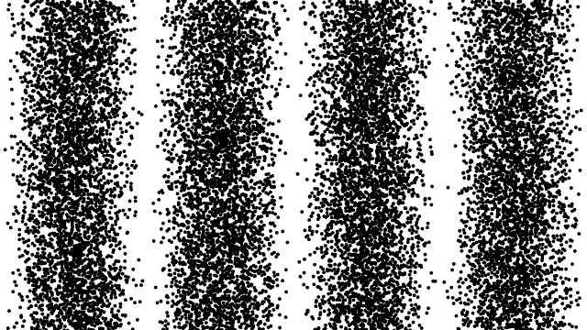
thanks for listening!

